Slide 1
TEAM 2
Fall 2018
[CEO Name] | CEO, [Company Name]
[Email Address]
[Phone]

Slide 2
Product Overview
Ordinary people only have limited knowledge of wine. When facing the obscure terminologies and indistinct description of taste, consumers could easily get overwhelmed and would spend considerable length time to comprehend. Also, choices are enormously based on occasion and purpose. The decision of choosing an appropriate wine would be better made according to reliable reviews and comments. Last but not least, the prices of wine vary greatly and could be overpriced sometimes.
Targeting the problems above, the product delivers succinct recommendations based on easily-understood category and feature selection. Also, easy access to simple yet comprehensive feedbacks are provided, including ratings from expert magazines and ratings from previous buyers. The product also carry out price comparison to help a customer to make his purchase at a reasonable and reliable price.

Slide 3
Product Features
Feature 1 – Descriptive & Statistical Analysis
Feature 2 – Search by Title & Price Comparison
Feature 3 – Search by Varietal & Display Details
Feature 4 – Search by Price Range
Feature 5 – Search by Region
Feature 6 – Search by Year
Feature 7 – Search by Taste
Feature 8 – Search by Combination of Category
Feature 9 – Similar Items Recommendation

Slide 4
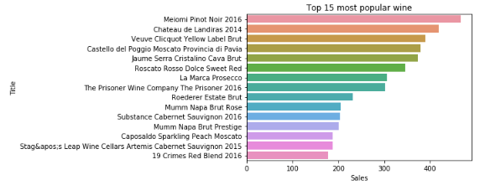
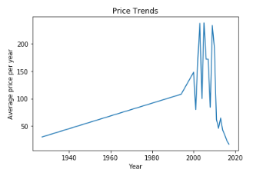
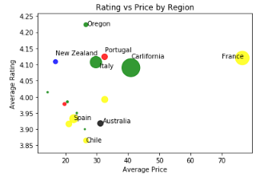
Feature 1 – Descriptive & Statistical Analysis
To help user gain a general perception of wine industry, we use real-time web-scraped data to conduct the descriptive & statistical analysis through an overall perspective, coving price, popularity, region, etc.
<screenshot or code>

Slide 5
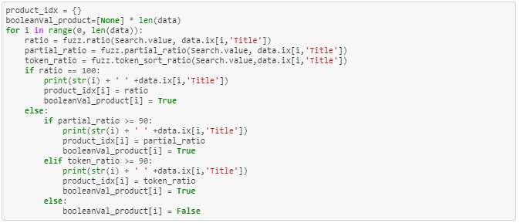
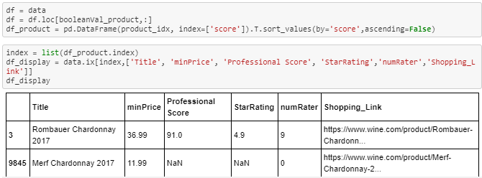
Feature 2 – Search by Title & Price Comparison
User can search certain wine by keywords in the name. By collecting price data from different website, a reliable comparison of price is provided for the same wine if user acquire for detailed price information.
<screenshot or code>

Slide 6
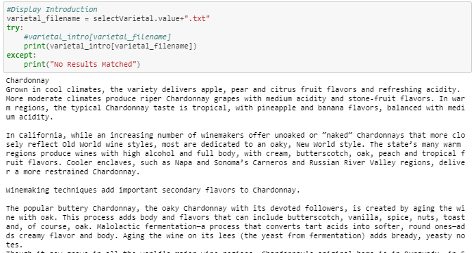
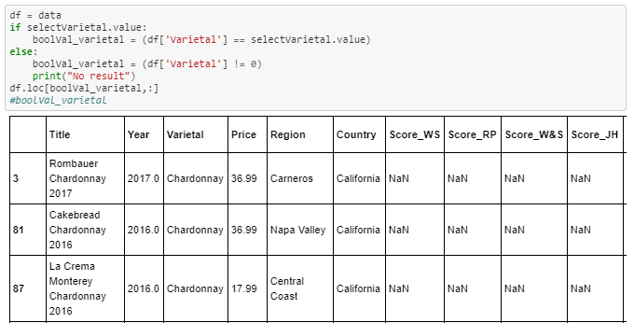
Feature 3 – Search by Varietal & Display Details
Tagging wines by their varietals is one of the product’s important unique feature. Users can search preferred varietals, maybe based on their previous experience. Also, detail description of certain varietal is provided for users to help them make decision.
<screenshot or code>

Slide 7
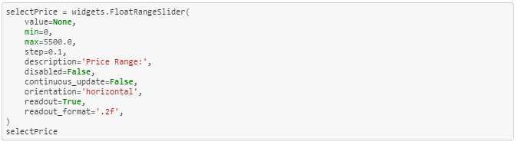
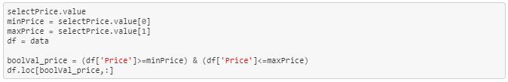
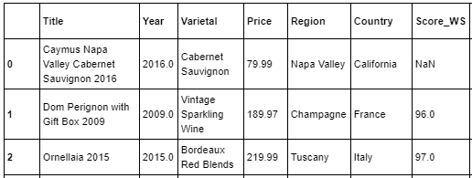
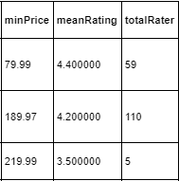
Feature 4 – Search by Price Range
Users can search wines under their preferred price range. The search result also provides the minimum price across websites along with the corresponding shopping link.
<screenshot or code>

Slide 8

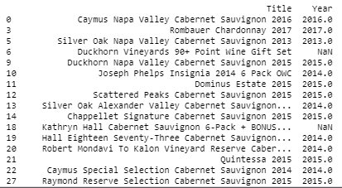
Feature 5 – Search by Region
Region is another distinguishable factor for wine flavor. The product provide feature of searching wine manufacturers in specific regions and countries by keyword.
<screenshot or code>

Slide 9
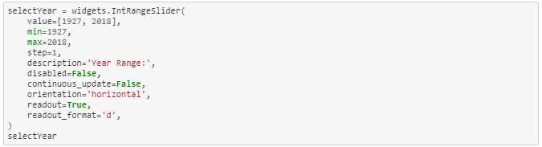

Feature 6 – Search by Year
Year is a significant attribute of wines, which means the wine made from grapes that were primarily grown and harvested in a single specified year. Consumers of wine normally pay attention to this information and thus the product provide the searching by year.

Slide 10
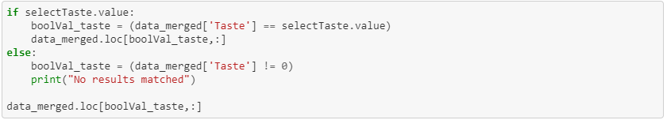
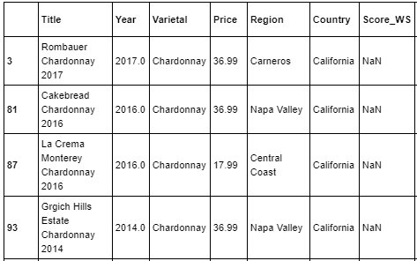
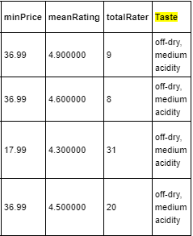
Feature 7 – Search by Taste
Based on research done on variety categories, our product extract couple of keywords to describe the flavor, fluidity, scent, etc. of wines made from corresponding varietal. Users can search description for taste to find the flavor they want.
<screenshot or code>

Slide 11
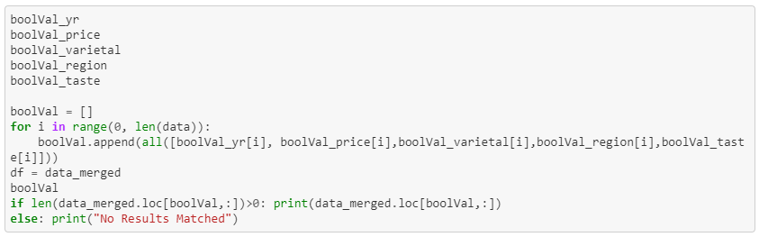
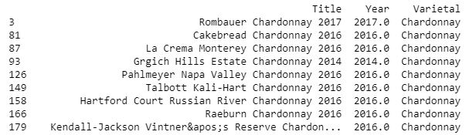
Feature 8 – Search by Combination of Category
Other than searching based on a single description, users can also search wine products using multiple conditions.
<screenshot or code>

Slide 12
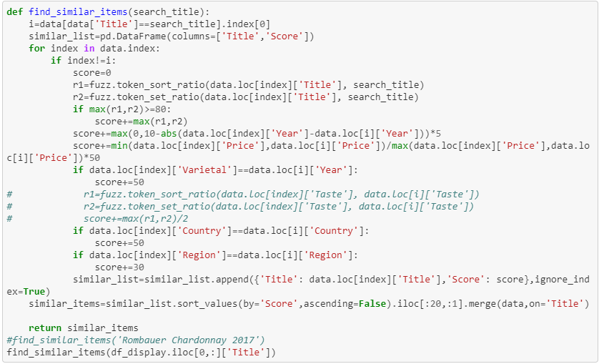
Feature 9 – Similar Items Recommendation
Based on the resemblance of region, year, varietal type and product name, the product calculate the similarity between different wines and provide similar recommendation for users.
<screenshot or code>

Slide 13
Deliverables
Git URL
https://github.com/95888Group02/data-focused-python
Project Board URL
https://trello.com/b/RgIdi2du

Slide 14
Additional Enhancements
Categorize wines with more specific and user-friendly tags, such as occasion, festival, purpose, dish style, etc.. And based on these categories, user of our product can know nothing about wine but still pick an appropriate bottle of wine.
Refine the recommendation by setting characteristics of wine mentioned above as factors and applying advanced algorithm to calculate accurate similarity.
With user’s browse record and purchase history, our company can provide features like “people who have bought this also buy/interested in …”, or ranking of wines by popularity within specific time period.

Slide 15
Lessons Learned
Communication: clearly inform roles, expectations and objectives of the project to each team member
Risk Recognition: identify potential roadblocks throughout the project and prepare plans for them
Adaptive schedule: set milestones in different stages to ensure project progress and change plans accordingly

